Slide 1
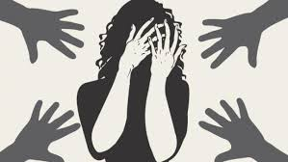


An analysis on criminal activities in Bangladesh
This analysis contain the criminal offence like murder ,rape, house breaking house trespus like offences which continuously increasing day by day in Bangladesh .

Slide 2
This project contains the information about crimes in Bangladesh and collect data regarding last few years
Murder
Rape
.murder refers to kill someone without any lawfull authority .
murder can also be considered as killing.
extra judicial killing also considered as murder which occur in the police custody .
Rafe refer to the unwilling sexual intercourse with someone .
element of rape contains panitration ,forced ,unwilling intercourse
it can also be marital rape though it is not applicable in our country .

Slide 3
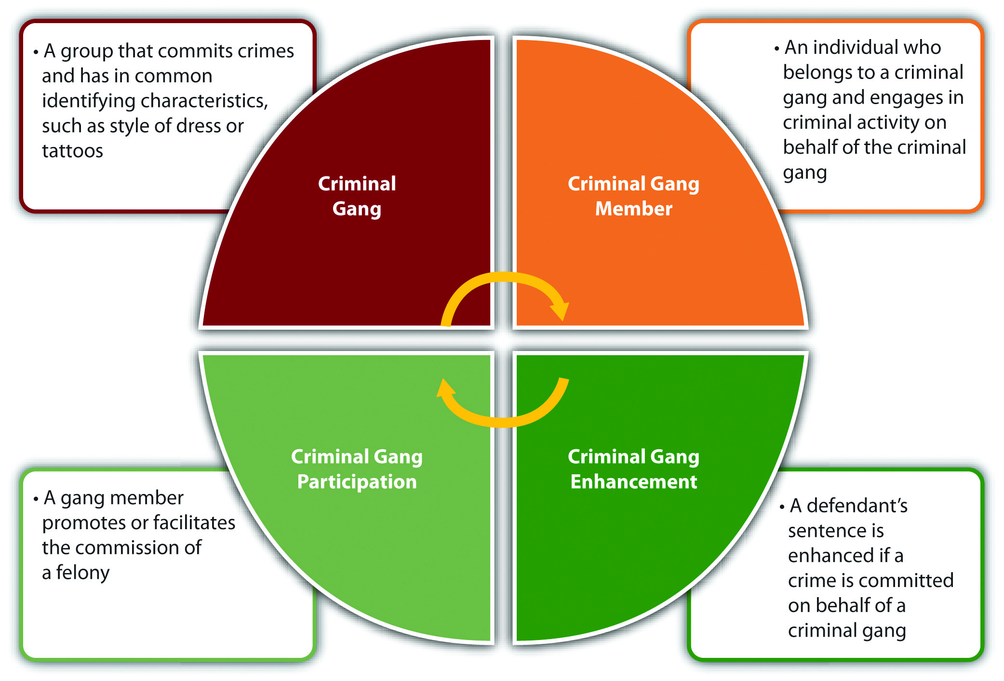
Here is a chart of criminal activities in Bangladesh

Slide 4
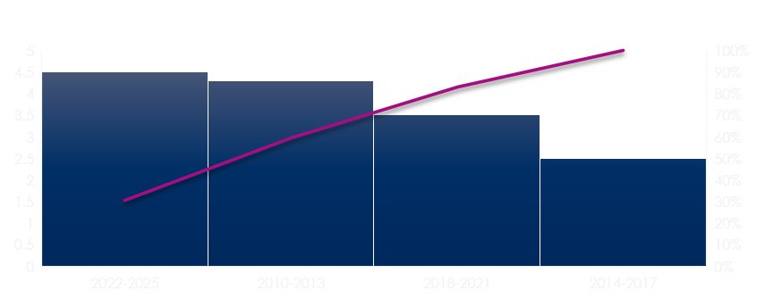
A chart shows crime rate in bangladesh

